Slide 1




Cancer Rate Analysis for Strategic Clinic Placement
By Shlok Yeolekar, Paul Thottappilly, Zach Storms, Hayden Lundin, Owen Althouse

Slide 2

Project Overview
We are a healthcare analytics team contracted by a private oncology provider to open 3 new clinics in the US.
Our Objectives:
Identify geographic and demographic “hot spots” where incidence and mortality rates are unusually high.
Inform strategic placement of new clinics to serve the greatest demand in a financially viable way
Support data‑driven decision making that balances community benefit and operational profitability.

Slide 3
Dataset Overview
For this analysis, we use two complementary datasets:
Cancer Regression
County‑level dataset with 33 features - demographics, socioeconomic status, lifestyle risks, and healthcare access
Two target variables: average annual cancer cases and average annual cancer‑related deaths
Hospital Financials & Capacity
Hospital‑level operational & financial statistics, aggregated by county to align with our cancer data
Key fields include facility capacity, workforce size, total costs & charges, asset/liability balances, net patient revenue
Integration goal: assess where cancer hot‑spots exist and evaluate the financial and operational capacity—or gaps—of local healthcare infrastructure to support new clinics
Notes:
Cancer Regression (Kaggle)
County‑level dataset with 33 features spanning demographics (age distributions), socioeconomic status (income, education), lifestyle risks (smoking, obesity), and healthcare access (insurance coverage, PCP density)
Two target variables: average annual cancer cases and average annual cancer‑related deaths per county
Designed for forecasting cancer severity and mapping high‑need areas to guide targeted interventions
Hospital Financials & Capacity (hospitalcosts.csv)
– Hospital‑level operational & financial statistics, aggregated to the county scale to align with our cancer data
Key fields: facility capacity (# beds), workforce size (FTE employees), total costs & charges (inpatient vs. outpatient), salary outlays, asset/liability balances (buildings, equipment, fund balances), net patient revenue, total income, net income, and cost‑to‑charge ratios
Integration goal: assess where cancer hot‑spots exist and evaluate the financial and operational capacity—or gaps—of local healthcare infrastructure to support new clinics

Slide 4
Methodology
Dimensionality Reduction and Clustering (PCA)
Conducted PCA with 10 variables into two axes—PC1 (socioeconomic & coverage) and PC2 (cancer burden & research)—and plotted counties on these components to reveal three distinct clusters.
Mapping Hotspots
By weighting the most statistically significant variables and the target clusters, we created an ‘opportunity score’ and mapped it to US counties to identify the best locations and hotspots
Predictive Modeling
Tested Random Forest and Gradient Boosting using features like total discharges, total number of beds, employees on payroll , is urban, total cost, total liabilities, total bed days available—Gradient Boosting performed best (Cases RMSE 1.48, R² 0.5682).
Key predictors driving performance were Total discharges, net income, and number of beds.
Notes:
Column cleaning & standardization: renamed all fields to snake_case; stripped “$”, commas, and trailing spaces from cost/revenue columns and converted them to floats
Type conversion & encoding: cast bed counts, FTEs, charges, and asset/liability figures to numeric types; encoded rural_vs_urban as a categorical variable
Missing‑value & duplicate handling: removed duplicate county–state entries, imputed small gaps, and dropped overly sparse columns
Dataset fusion & new metrics: joined cancer and hospital data by county/state and derived efficiency ratios (e.g., cost‑to‑charge, beds per population)
County‑level aggregation of hospital operational and financial metrics to align with cancer data
Facility capacity & workforce: number of beds and FTE employees
Cost & revenue metrics: inpatient vs. outpatient costs and charges, salary outlays, net patient revenue, total and net income, cost‑to‑charge ratios
Asset/liability health: balances for buildings, equipment, and fund reserves—enabling assessment of infrastructure capacity and gaps to support new clinics in cancer hot‑spots

Slide 5
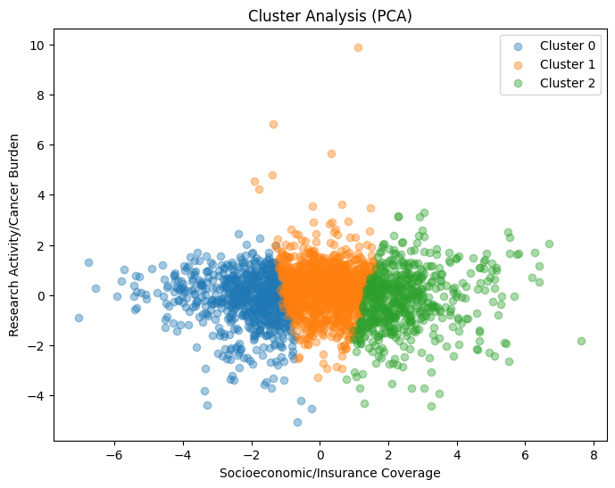
Demographic Clusters
Top priority → Cluster 1 (Orange)
﻿﻿Highest mortality and highest incidence rate despite decent research activity.
﻿﻿Placing clinics here reaches urgent, high-volume patients.
Second priority → Cluster 0 (Blue)
﻿﻿Poor and under-resourced with moderate burden
﻿﻿Clinics here will improve access where public coverage is high and private coverage low.
Lower priority → Cluster 2 (Green)
﻿﻿Wealthy, well-covered counties with moderate death rates.
﻿﻿Existing infrastructure likely meets most of their demand.
Notes:
So this slide shows a cluster analysis, where about half the variables in the dataset were accounted for, since they were the most statistically significant ones. Since a cluster analysis can only have 2 dimensions I did a PCA conversion for it and then conducted the cluster analysis.

Slide 6
Map Analysis
After layering our geographical maps and constructing an opportunity score (based on mortality rate, private insurance rate, poverty, and median income), these are some of the most viable counties:
Loudoun County, Virginia
Chester County, Pennsylvania
Hunterdon County, New Jersey
Oldham County, Kentucky
Hamilton County, Indiana
Delaware County, Ohio
Scott County, Minnesota
Campbell County, Wyoming
Douglas County, Colorado

Slide 7
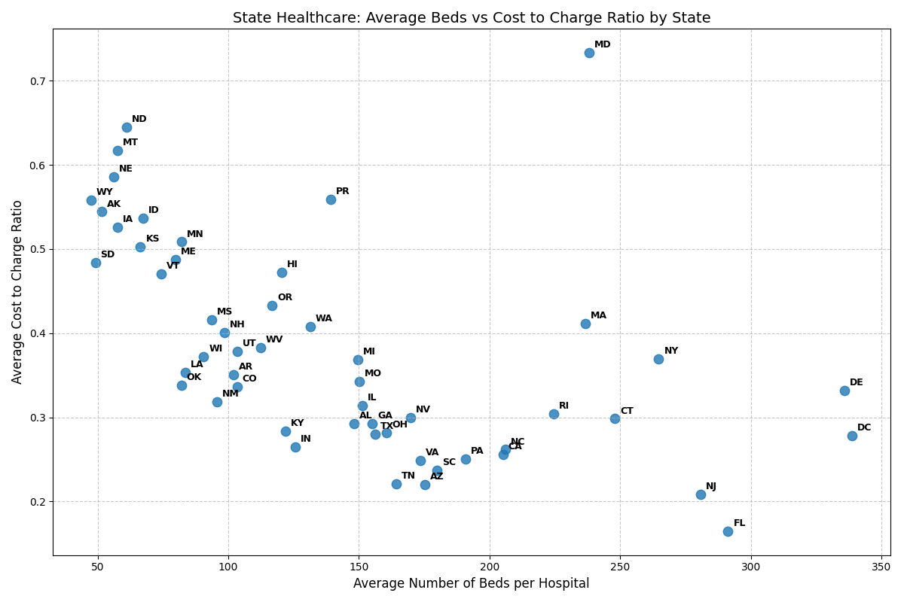
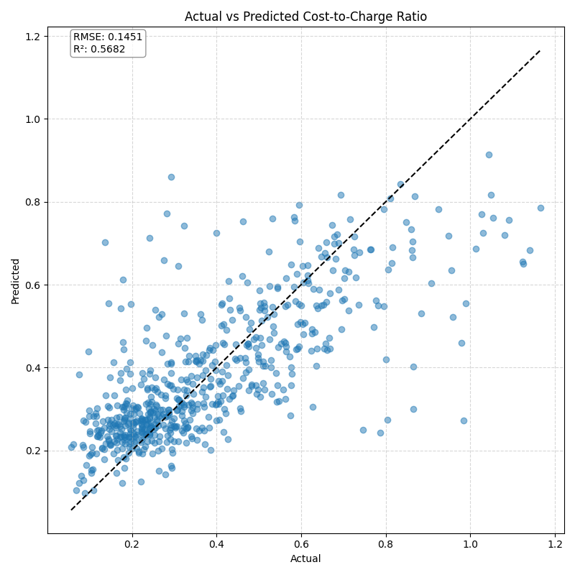
Cost to Charge State Analysis

Slide 8
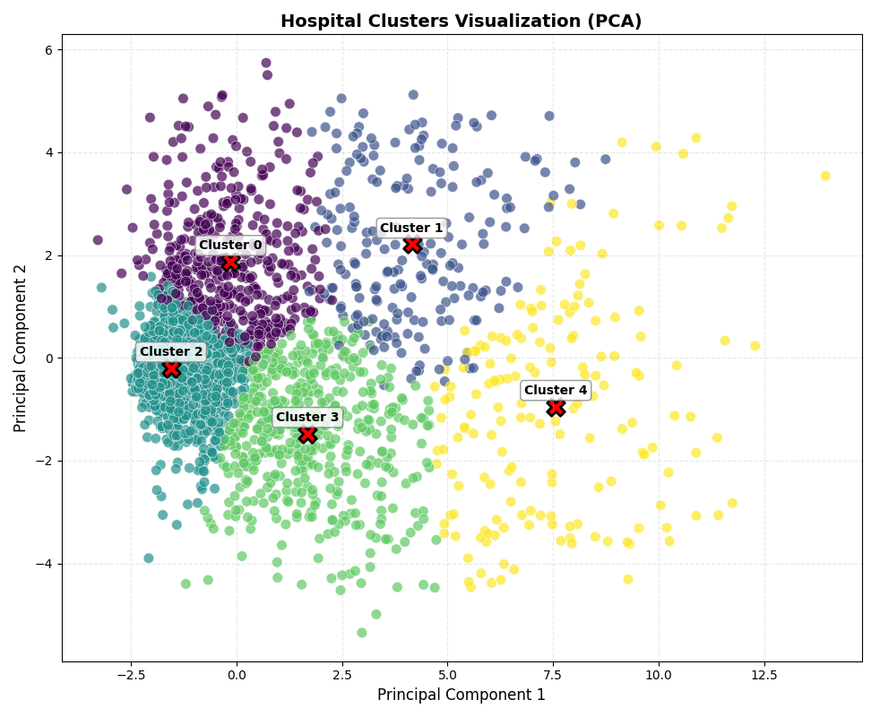
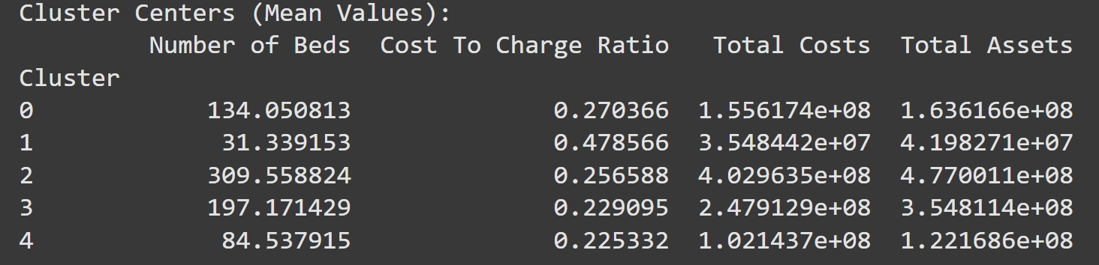
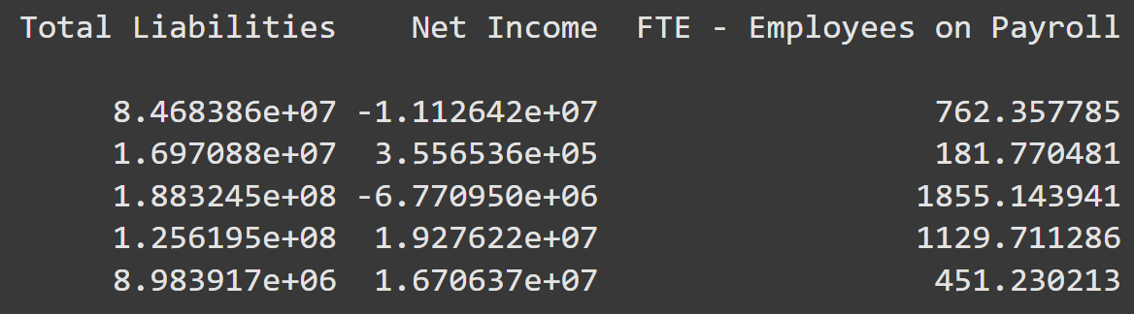
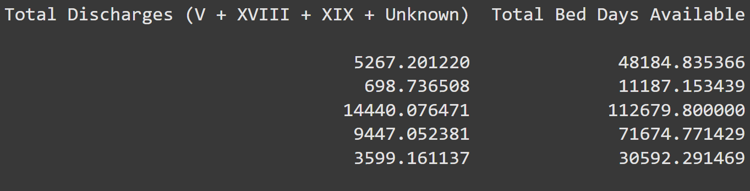
Hospital Financial Cluster Analysis
Notes:
Clustering (K‑Means, K = 5)
Five clusters with assigned priorities: Affluent/high-volume (low priority), Research hubs (secondary priority), Under‑resourced (equity‑focus), and High‑need/moderate resources (top priority).
Predictive Modeling
Tested Linear Regression, Random Forest, and Gradient Boosting using features like 1‑year incidence lag, 3‑month rolling averages, and poverty×access interaction—Gradient Boosting performed best (Cases RMSE 32.1, R² 0.72; Deaths RMSE 26.7, R² 0.68).
Key predictors driving performance were 1‑year lagged incidence, poverty rate, and beds per capita.
Operational Recommendation
Prioritize clinic deployment in Cluster 3 counties where burden is high but infrastructure gaps exist Then extend to Cluster 2 for equity in underserved areas.

Slide 9


Conclusion
Analysis identified critical gaps in cancer care access, based on weighted features we prioritized counties for new clinic placement and 9 target locations selected using the opportunity score and Tableau heat map.
Operational and financial data will be used to finalize site selection.
This targeted, data-driven strategy maximizes impact, advances health equity, and delivers clinics where they are needed most.
List clinic placement here
Loudoun County, Virginia. Opportunity Score - .9063, Leesburg population- 48, 788
Oldham County, Kentucky. Opportunity Score- .8554. population - 67, 000
Hamilton County, Indiana. Opportunity Score- .8496 Carmel population- 100,000
Next Steps: Competitor analysis of counties.
Notes:
Loudoun County- High private insurance rate, birth rate, and median income leading to sustain profitability.
Oldham County, Kentucky- High incidence rate, median income, and private insurance. This county is a cancer hotspot due to its incidence rate. Suburb of Louisville
Hamilton County, Indiana - High birth rate, private insurance, and high median income.
Large hospitals not ideal, midsize are the most preferable
Weighted features- target death rate, median income, private insurance coverage, and poverty
Wanted a hospital in an area with 50k to 60k people

